Slide 1

Smart Mobility: Traffic & Parking Management
The Digital Twin for Optimized Mobility
Made by
Marvin Beste
Viktor Reiswich
Petra Czettisch
Leander Lohaus
Notes:
As cities grow denser, traffic efficiency and parking availability are becoming critical challenges. Our goal is to find smarter ways to predict, monitor, and manage mobility patterns, using real-time information and intelligent systems to make city transport smoother and more efficient. And we have to admit, the inspiration partly came from experiencing Greek traffic firsthand. It’s so chaotic.

Slide 2
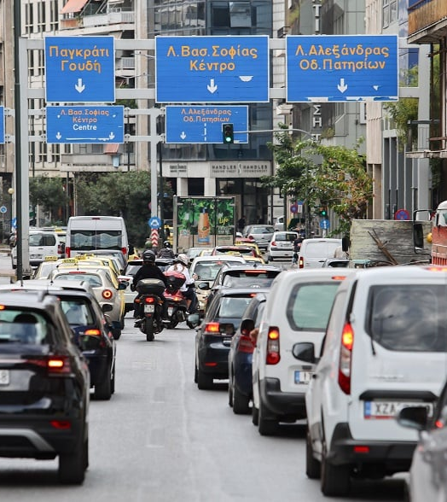
The Problems
Traffic:
Traffic violations
Accident rates
Driver behavior & awareness
Road safety
Peak-hour congestion
Parking:
Cut cruising
Double parking
Notes:
To understand what needs improvement, we first looked at the major issues in current mobility systems. Starting with traffic: a high number of traffic violations and accidents, often linked to poor driver behavior and low awareness. Road safety remains a big concern, especially during peak-hour congestion, when the city’s infrastructure is pushed to its limits. These problems lead to lost time, pollution, and frustration. When it comes to parking, the situation is similar. A lot of time is lost simply by cruising for available spots, which increases overall traffic density. Double parking is another major issue, it blocks lanes, creates safety hazards, and disrupts the flow of vehicles. Together, these challenges show that traffic and parking can’t be treated separately. They are part of the same urban ecosystem.

Slide 3
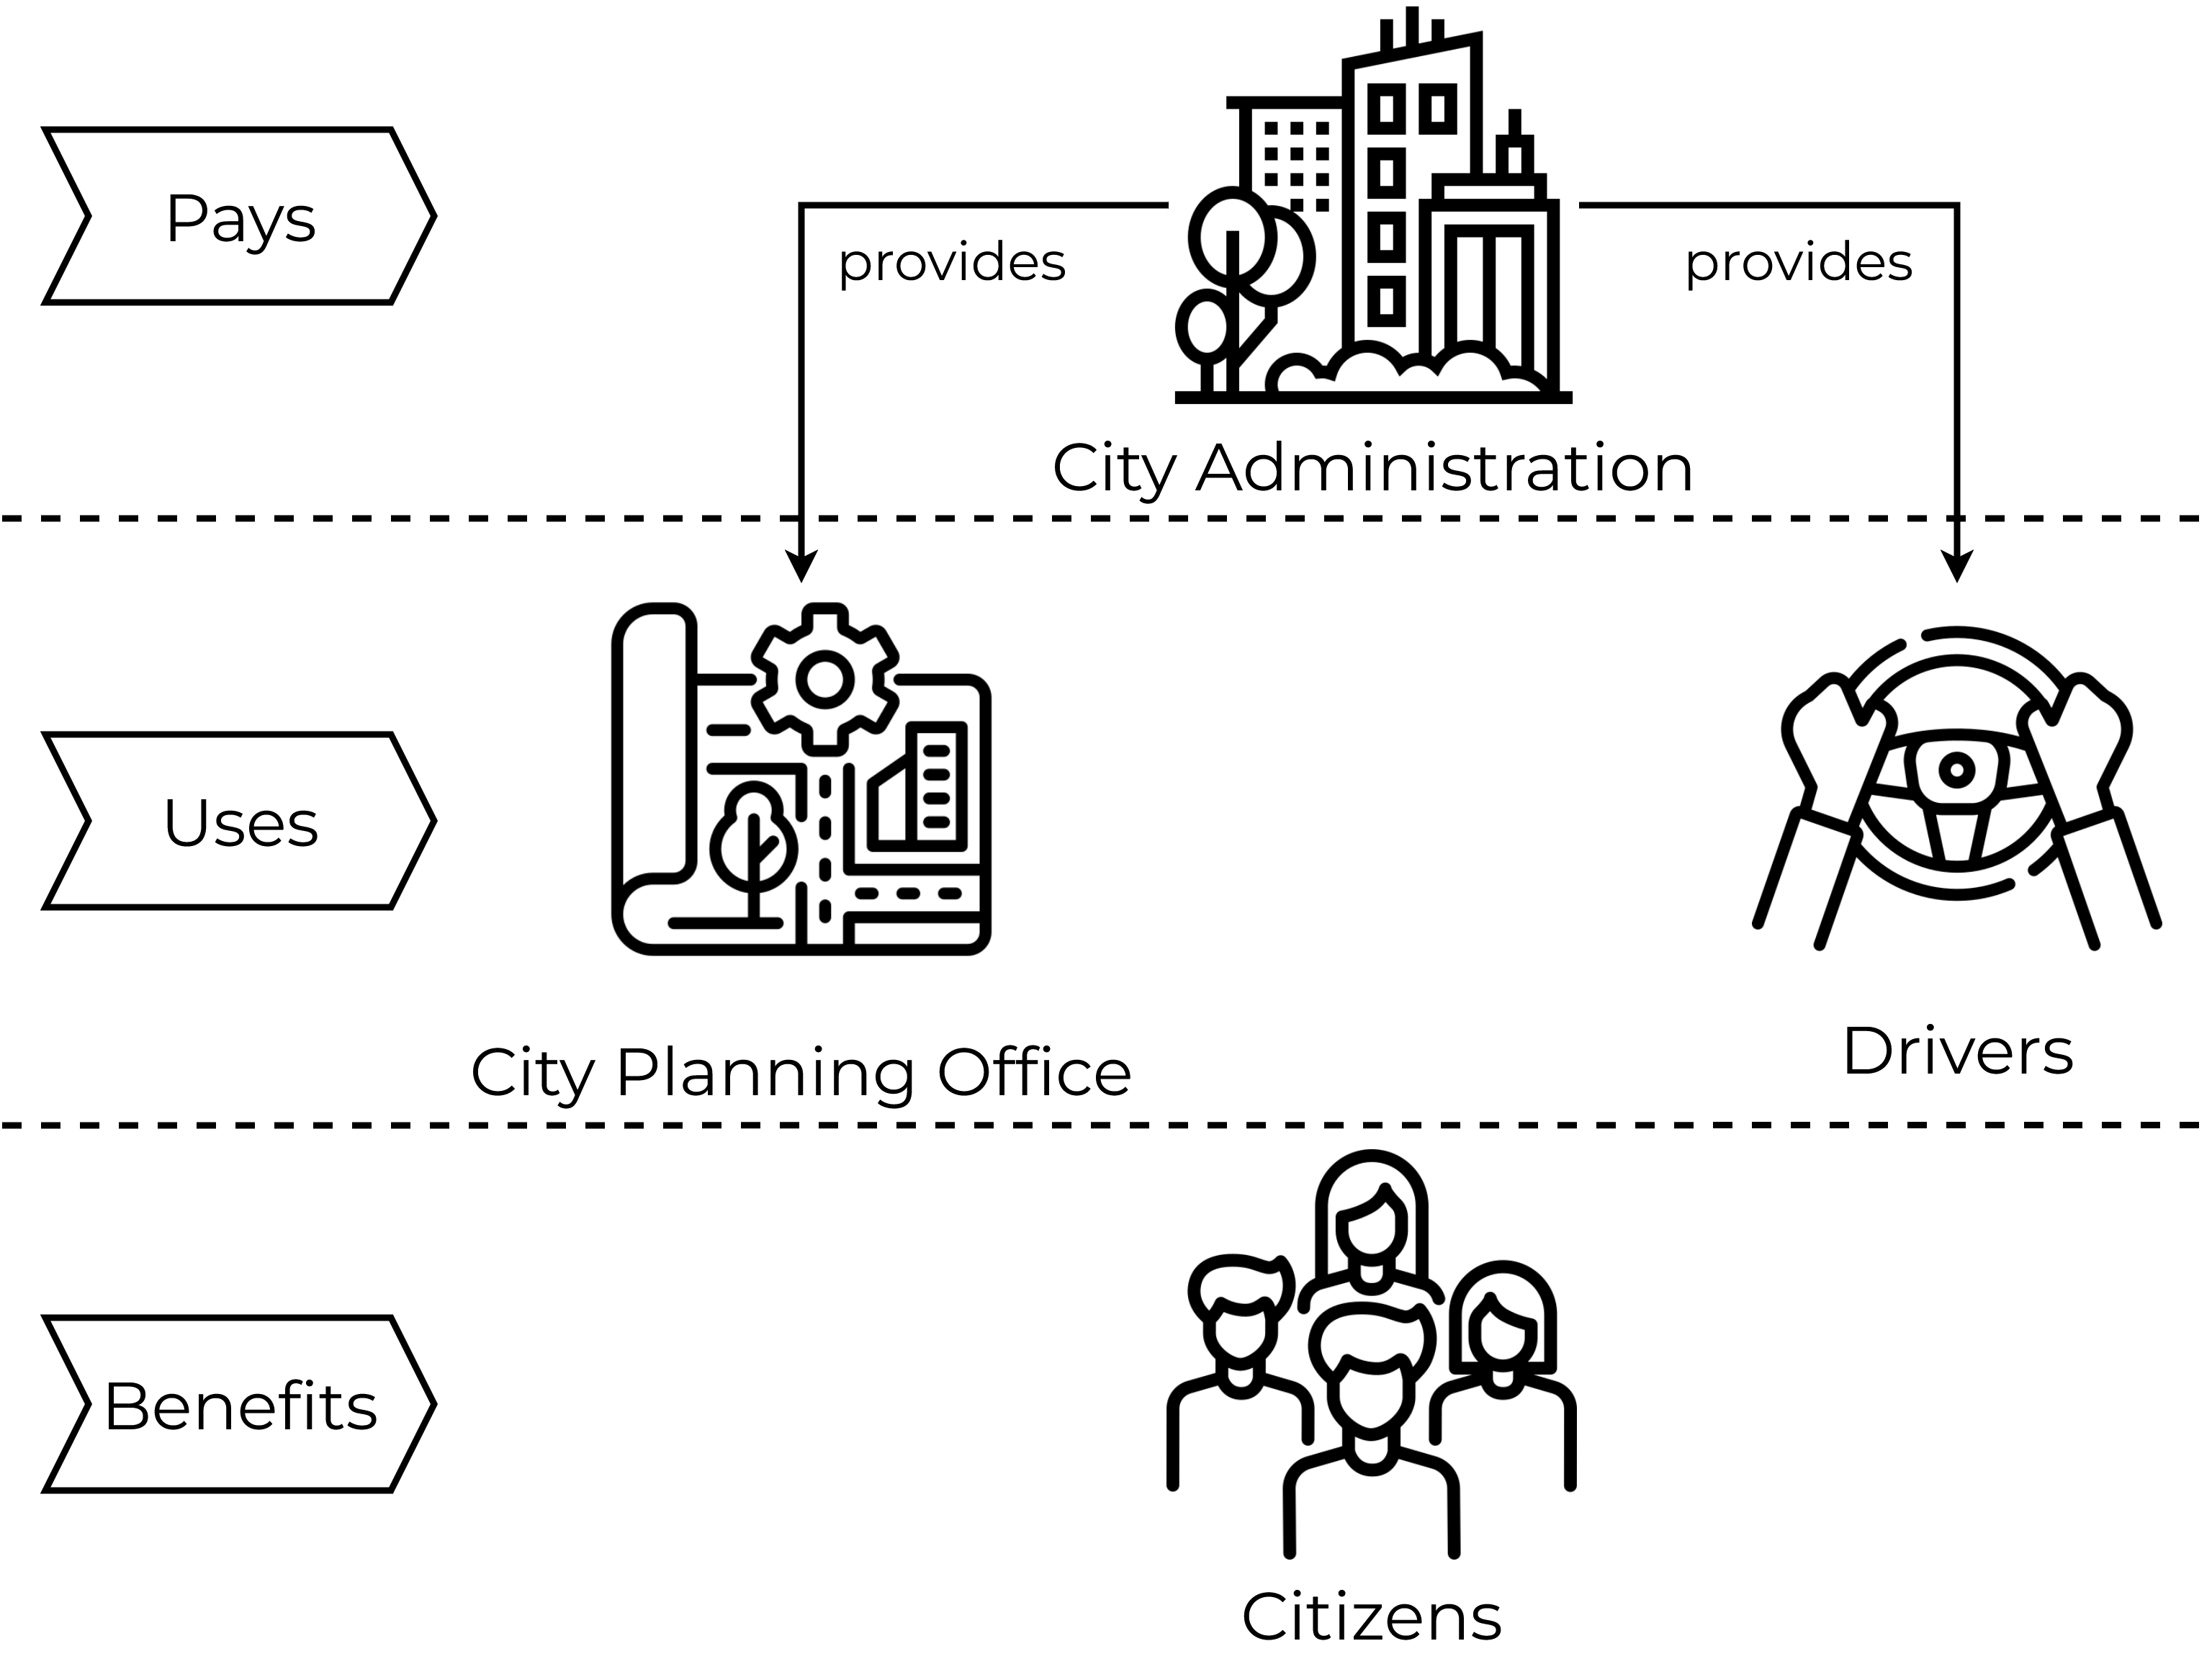
Our Target Group
Notes:
Our system involves several key stakeholders. At the top is the City Administration, which funds the system and gains tools to monitor mobility and enforce regulations more efficiently. Next, the City Planning Office uses the collected data to make informed decisions, for example, adjusting signal timings, planning new parking zones, or improving road layouts. Drivers benefit from real-time information, finding parking faster, reducing unnecessary driving, and improving safety. And finally, Citizens experience the broader effects: reduced congestion, cleaner air, and smoother daily movement across the city. By connecting these groups through a single data-driven mobility platform, we can make cities function better, and maybe, just maybe, make Greek traffic a little less chaotic. Transition: Now, let’s take a closer look at what makes our solution unique compared to other options available on the market.

Slide 4

Unique Value Proposition
A scalable All-In-One IoT Solution that unites drivers and city authorities to optimize parking, traffic flow, and urban mobility.
Notes:
Connects drivers and cities in one scalable platform
Combines parking, traffic, and analytics into a single ecosystem
Delivers real-time insights and rewards to improve mobility and safety
Transition: So, how do we actually deliver this value? It starts with what cities can do inside our platform.

Slide 5

Our Solution: City Administration & Planning Office
Adaptive Analytics Dashboard: Combines heatmap and graph views for real-time traffic, parking, and safety insights
Advanced Filtering: Analyze specific timeframes or focus areas for deeper planning insights
Urban Simulation Engine: Test the impact of planned changes
Improvement Suggestions: AI-based recommendations for signage, road markings, and infrastructure design
Automated Emergency Response: Sends instant alerts to authorities
Notes:
Turns mobility data into real-time insights for planners.
Dashboard: Heatmap & graphs for traffic, parking, safety.
Filtering: Focus on timeframes or hotspots.
Simulation: Test effects of new roads or policies.
AI Suggestions: Smart fixes for infrastructure.
Emergency Alerts: Instant notifications to authorities.
Builds a data-driven foundation for smarter city planning.
Transition: Now let’s see how drivers interact with this system on their side.

Slide 6

Our Solution: End-User (Drivers)
Smart Parking & Rerouting: Real-time route and parking suggestions
Dynamic Map View: Live traffic, risks, and parking updates
Safety Alerts: Instant warnings for weather and road hazards.
Community Reporting: Report accidents & road hazards
Reward System: Earn rewards for safe & lawful driving
Driving Preferences: Avoid narrow, risky, or busy streets
EV Charging Integration: Smart suggestions for nearby stations.
Notes:
Safety alerts via popups and voiceinputs / audio over speakers
Reward System: city chooses to participate in rewarding : discounts or coupons
EV Charging: only select parking spaces with EV station

Slide 7
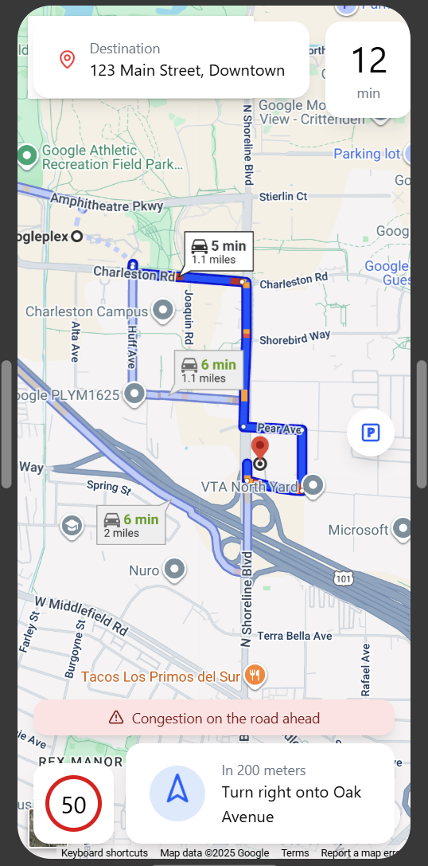
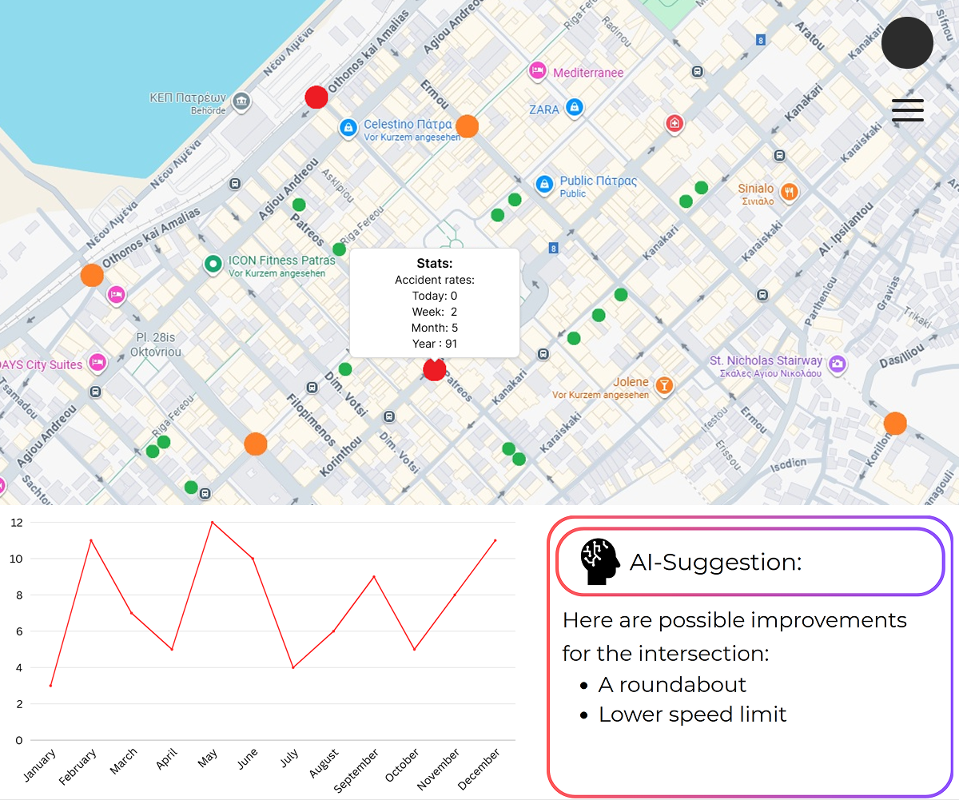
The Web Draft
Notes:
Heatmap shows where accidents happen the most, parking spots can be seen how often they are used
Statistics can be shown in a Graph for specific areas
App:
navigation
Speedlimit
popups (will also be played via speakers)
Shows congestions and you can avoid them
Switch to parking mode

Slide 8
What Sets Us Apart
Scalable & Cost-Efficient: Easy to deploy, affordable to expand
Positive Reinforcement System: Rewards good driving instead of punishing mistakes
Unified Urban Platform: Connects traffic, parking, and safety in one system
Predictive Intelligence: Simulates city changes before they happen
Notes:
Scalable because every city can use this system. Villages, small city, big city…
Cost-efficient because of our cheap kits
Easy to deploy: we dont need on board systems in cars to collect data
Positive Reinforcment system: People more likely to use apps because of possible rewards. Other apps dont use it.
Unified urban Platform: You only need one app for everything instead of individual apps for every function
Other Companys only other specific solutions (Siemens: traffic lights system), or a hub for many solutions (IBM). Our Solution ist All-In-One

Slide 9
The Pricing
Component | Cost
Hardware Kit (incl. Installation) | 1.000€
Monthly Hardware Maintenance Fee (per Kit) | 5€
Monthly SaaS Fee (Base) | 1.000€
Monthly SaaS Fee (per Kit) | 15€
Hardware Kit:
Raspberry Pi 4
Camera Module
Installation Recommandation:
1 Kit per Crossing
1 Kit for 25m of road
Notes:
Raspberry Pi 4 so the camera is easy to use. We can use a lot of possible protocols like LoRa, 4G, WLAN and so on
Raspberry Pi camera modules with 200 FOV
Hardware kit installation: Time for the installation, costs for the technician, connecting to server, connecting power…
Maintenance: Cleaning, new lense, reparing…
SaaS Base: Costs for setting up the server/cloud (azure for example) and connecting every kit to the system
SaaS Fee per Kit: for every additional Kit, so its more convenient to install more because of the cost for the base fee
Installation recommendation can depend. 25m because of 200 FOV

